Slide 1
DATA VISUALIZATION
IV SEMESTER
R20 REGULATION
L/T/P/C: 3/0/0/3
LECTURE SESSION - 1

Slide 2
COURSE OBJECTIVE
To understand the visual representation of structured and unstructured data.
COURSE OUTCOMES
After completion of the course, the students will be able to
1. Understand the visualization and Data basics
2. Understand the Visualization process and know the representation of Spatial & Geospatial data
3. Analyse various Visualization techniques for Multivariate data and other structures of data
4. Interacting the different operators and different data spaces
5. Design effective visualization of modern toolkits

Slide 3
What is Data ?
Now, if we talk about data mainly in the field of science, then the answer to “what is data” will be that data is different types of information that usually is formatted in a particular manner.
All the software is divided into two major categories, and those are programs and data. Programs are the collection made of instructions that are used to manipulate data.
(Geospatial data is information that describes objects, events or other features with a location on or near the surface of the earth.)

Slide 4
Sources of Data
Growth in the field of technology, specifically in smartphones has led to text, video, and audio is included under data plus the web and log activity records as well. Most of this data is unstructured.
The meaning of data expands beyond the processing of data in computing applications. When it comes to what data science is, a body made of facts is called data science.
Accordingly, finance, demographics, health, and marketing also have different meanings of data, which ultimately make up different answers for what is data.

Slide 5

Case study of Instagram
What does the user submit?
What Information is collected?
This Photo by Unknown Author is licensed under CC BY-SA-NC

Slide 6
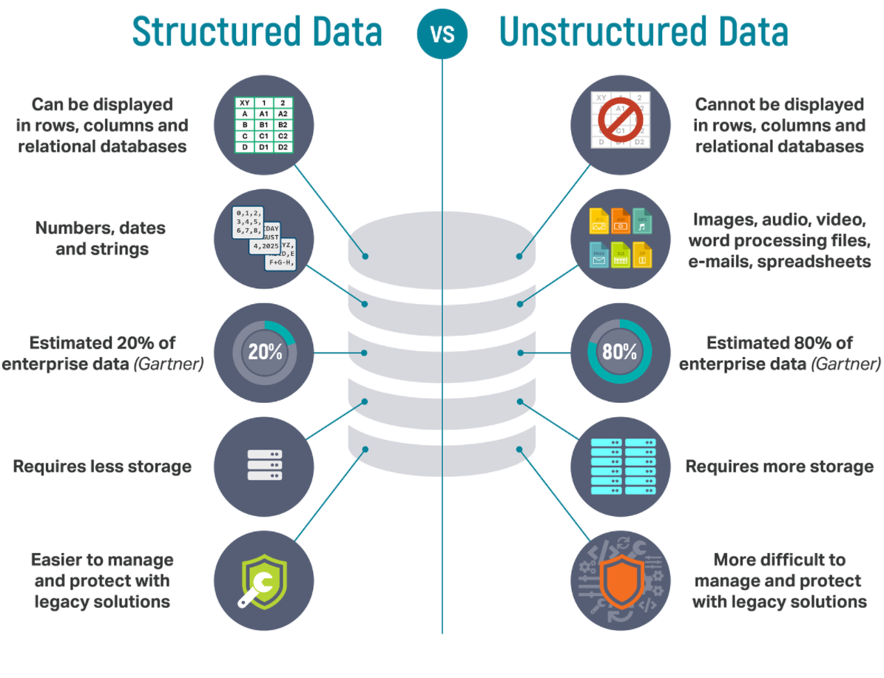
TYPES OF Data

Slide 7
Dimensions of Data
1 Dimensional Data
2 Dimensional Data
3 Dimensional Data
‘n’ Dimensional Data

Slide 8
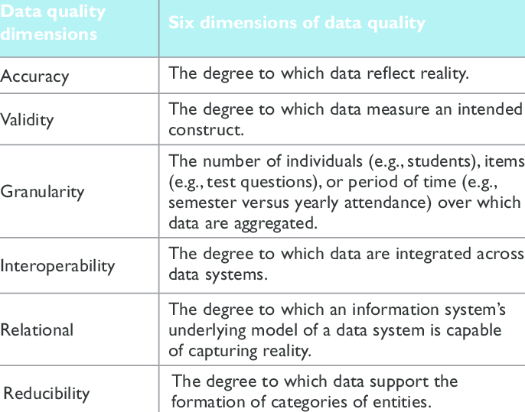
Measures for Quality of Data

Slide 9
INTRODUCTION
What is data visualization?
Data visualization is the representation of data through the use of common graphics, such as charts, plots, infographics, and even animations.
These visual displays of information communicate complex data relationships and data-driven insights in a way that is easy to understand.

Slide 10
Science Behind Data Visualization
The science of data visualization comes from an understanding of how humans gather and process information.
Eg: Here is the annual sales report of products and services, In Jan the revenue from products is 11 Lakh rupees and services is 32 Lakh rupees. In the month of February revenue from products is 18 Lakh rupees and services is 34 Lakh rupees. In a similar fashion, the statistics for the month of March are as follows, the revenue from products is around 14 Lakh rupees and services is close to 28 Lakh rupees

Slide 11
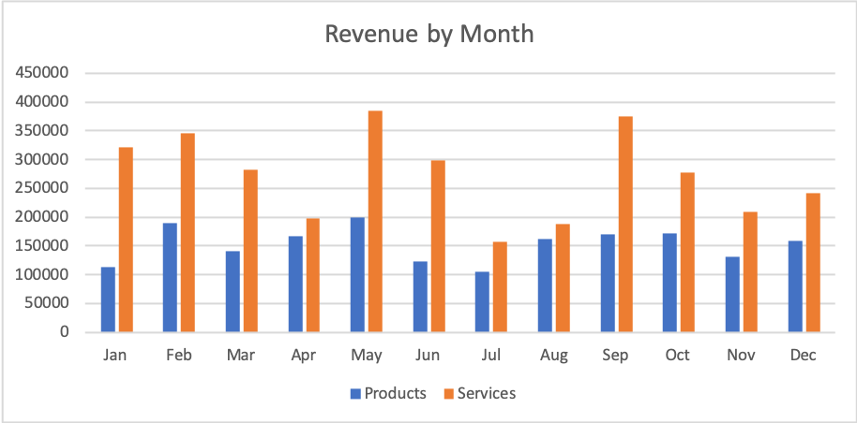
Sample Visualized Data

Slide 12
Where do we use Data Visualization?
Data visualization tools can be used in a variety of ways. The most common use today is as a business intelligence (BI) reporting tool. Users can set up visualization tools to generate automatic dashboards that track company performance across key performance indicators (KPIs) and visually interpret the results.
The generated images may also include interactive capabilities, enabling users to manipulate them or look more closely into the data for questioning and analysis. Indicators designed to alert users when data has been updated or when predefined conditions occur can also be integrated.

Slide 13
Contd.
Many business departments implement data visualization software to track their own initiatives. For example, a marketing team might implement the software to monitor the performance of an email campaign, tracking metrics like open rate, click-through rate and conversion rate.
As data visualization vendors extend the functionality of these tools, they are increasingly being used as front ends for more sophisticated big data environments. In this setting, data visualization software helps data engineers and scientists keep track of data sources and do basic exploratory analysis of data sets prior to or after more detailed advanced analyses.

Slide 14
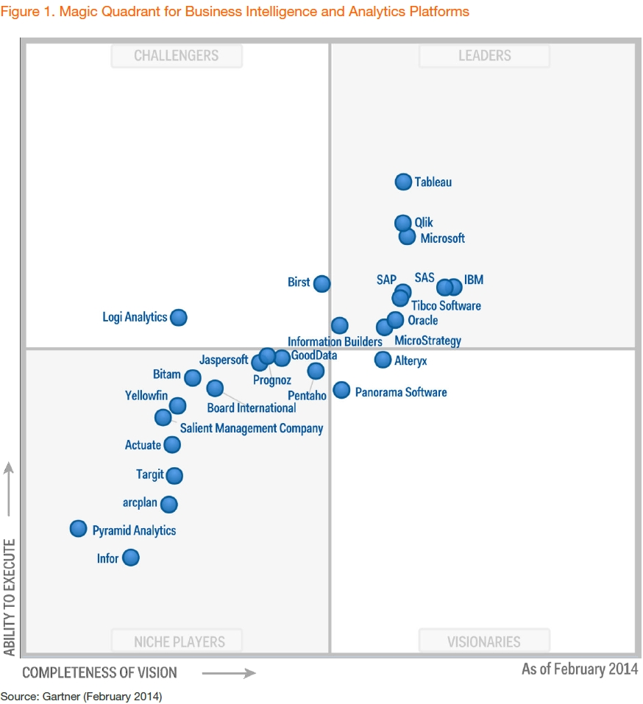
Leaders in Data Visualization

Slide 15
Most widely used Data Visualization Software's
While Microsoft Excel continues to be a popular tool for data visualization, others have been created that provide more sophisticated abilities:
IBM Cognos Analytics
Qlik Sense and QlikView
Microsoft Power BI
Oracle Visual Analyzer
Google Charts

